Slide 1
iTower
Final

Slide 2
Outline
Project Introduction
Game Design
Agent Design
Conclusion
Demo

Slide 3
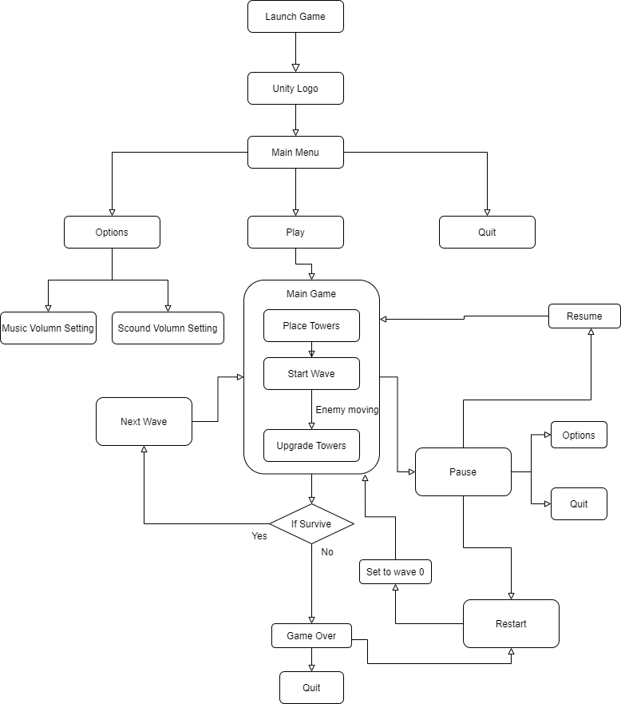
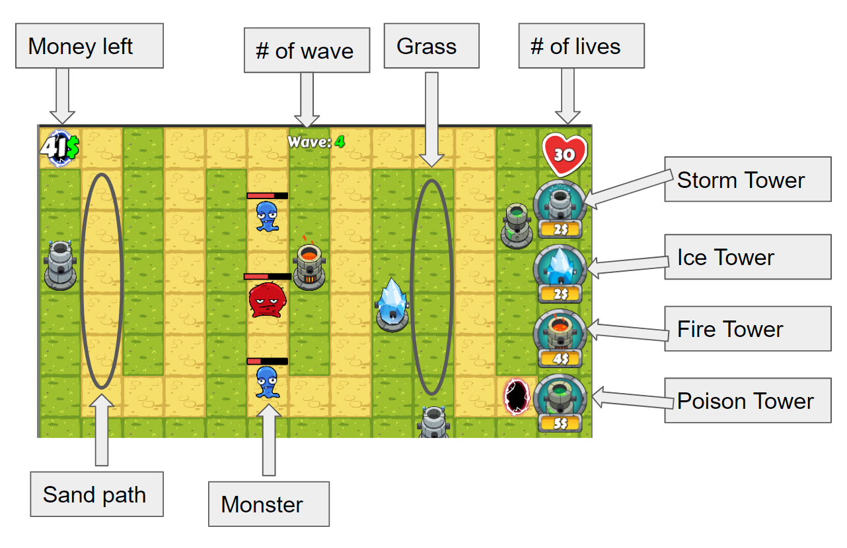
Game Introduction
Game workflow

Slide 4
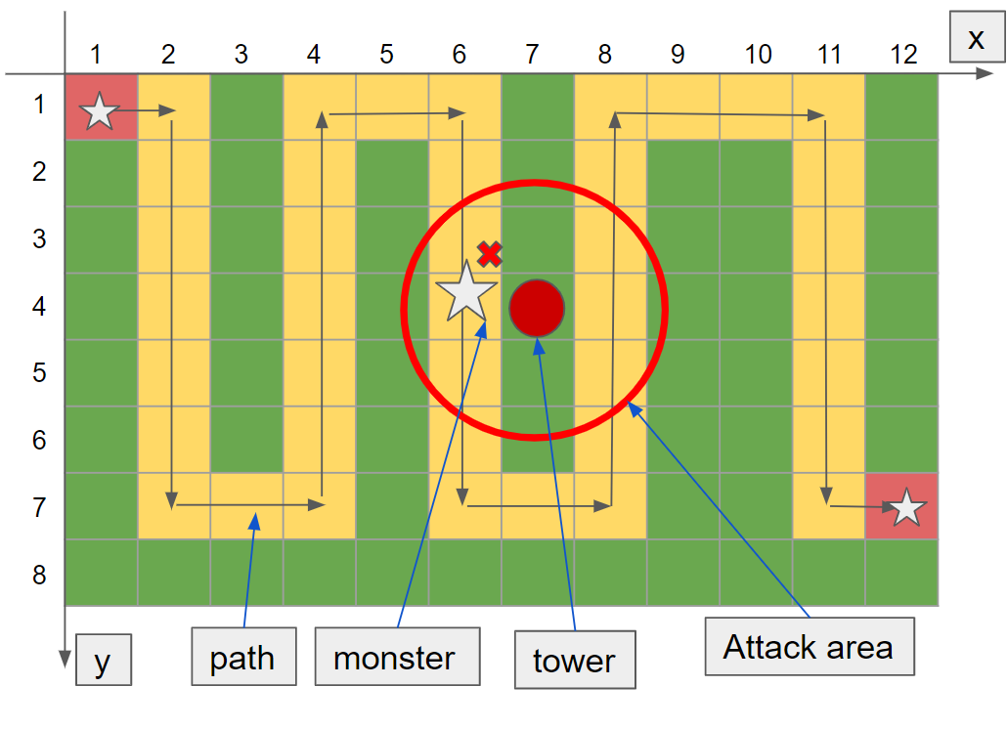
Project Objective
Create an agent that could learn to play the game wisely (higher current money and life at the same time)
Factors to be considered:
Current money: numbers
Current monsters: numbers and types
Towers: costs and types
Expected agent behaviors:
Select the proper types of towers
Place towers at proper time and location
Upgrade properties of the towers.

Slide 5
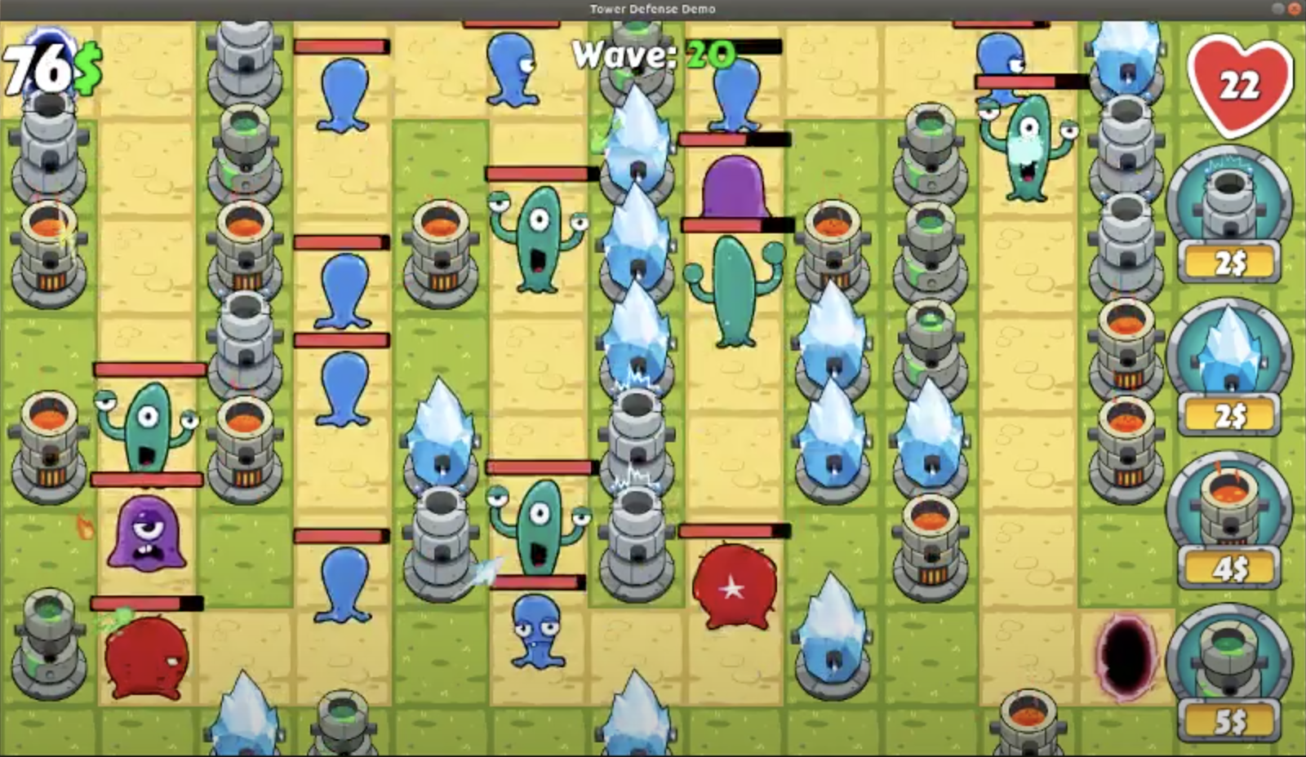
Prior Research
Game Research:
Jesse Huang, 2D-Tower-Defense-Demo https://github.com/JessHua159, 2017
Machine Learning Mechanism:
CNN classification model
NN regression model

Slide 6
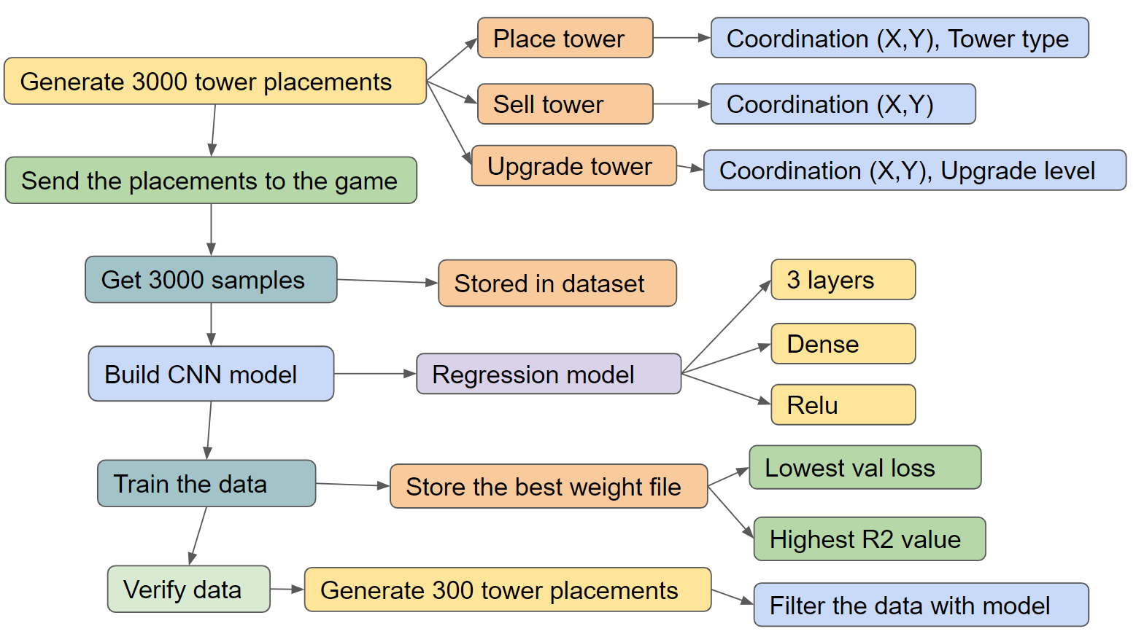
Project Details
Game Modification
Communication Design
Raw Data Collection
Data Pre-processing
Machine Learning Application

Slide 7
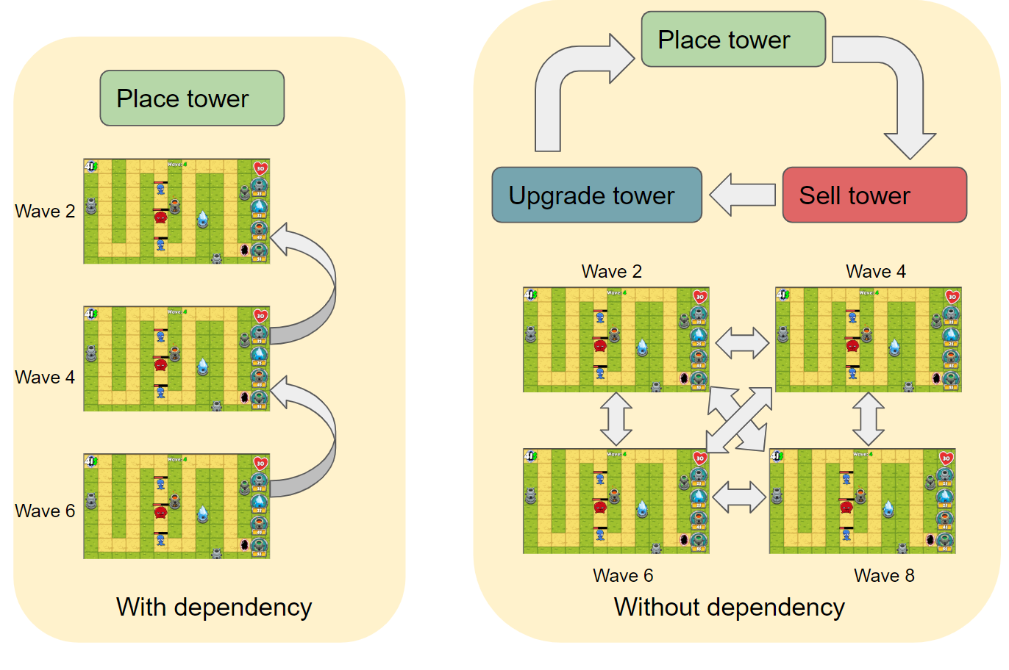
Game Modification - Dependency Removal
CNN Classification Model:
Doesn’t care about dependency
NN Regression Model:
Must remove dependency
Current sequence:
Place tower
Sell tower
Upgrade tower

Slide 8
Game Modification - Others
Events | Before | Adjustments | After
Error handling | Monsters stuck at birthplace sometimes | Set a max threshold time for each wave to auto restart | Game and ML process go smoothly
Game termination | Game terminated when no money or lives left. Max survived wave number is 20 | Increase initial money and lives dramatically | Max survived wave number is 22

Slide 9
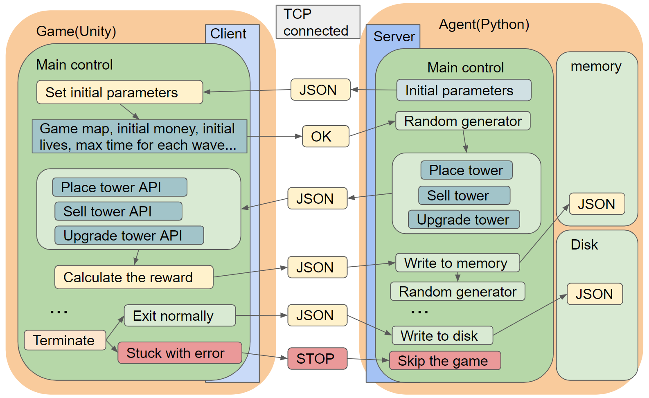
Communication Design

Slide 10
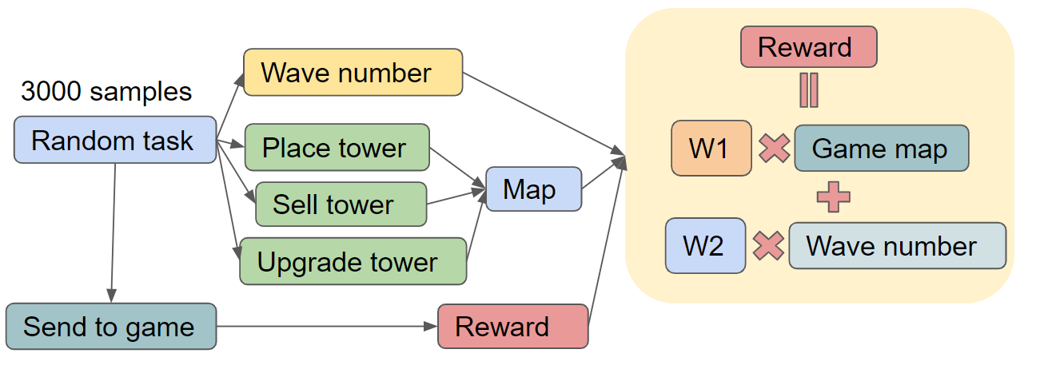
Raw Data Collection
Over 3,000 raw dataset for neural network regression training
Data Contents:
Game map: 8*12*4 3D matrix containing tower type and coordinates
Wave number to store the state of the game
Total life remaining

Slide 11
Data Pre-processing
3,000 groups of carefully selected data based on the following criteria:
Eliminate the incorrect data due to the game bug
Normalized the tower placement data using minmax scaler normalization
Computed the reward for each wave
Reward = Total life remaining + Monsters' shortest remaining distance to the end
= F(game map, wave number)

Slide 12
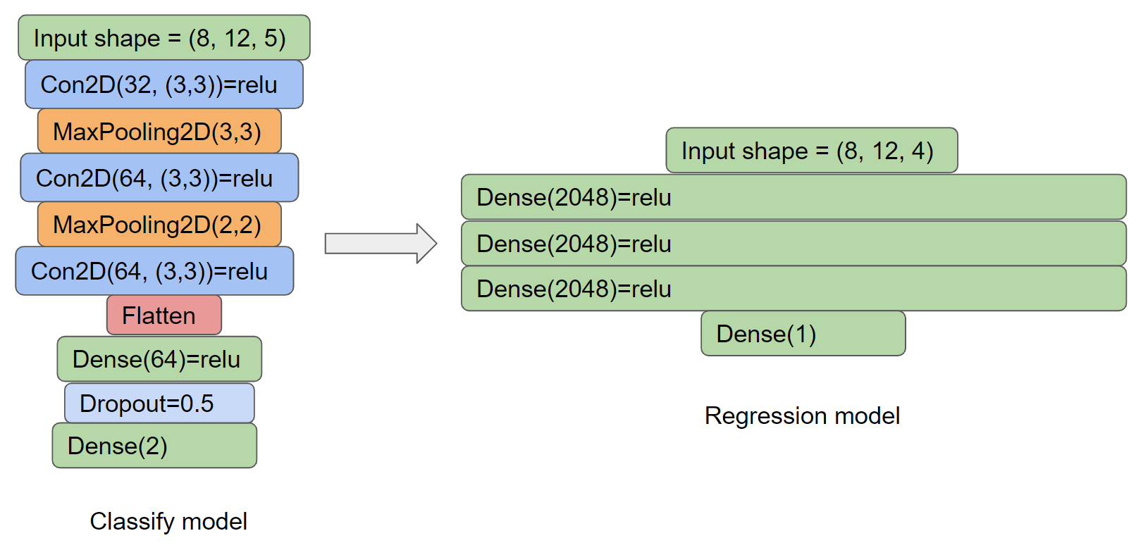
ML Application
CNN Classification Model (Before Midterm) | Deep Neural Network Regression Model
Use # of monsters killed & money earned as reward Game map as a image Different tower as different channels Binary classification Performance falls after waves | Use life remain & distance of monsters passed as reward Game map as a image Different tower as different channels Regression to predict the reward Performance significantly improved
Reward = Total life remaining +
Monsters' min(distance)
= F(game_map, wave_number)

Slide 13
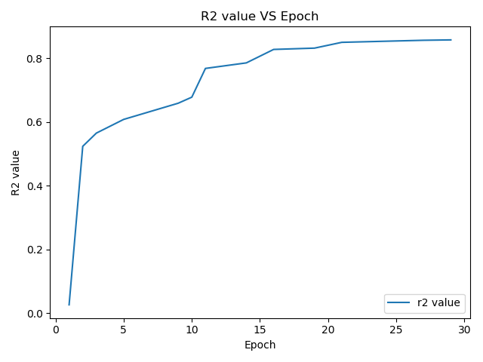
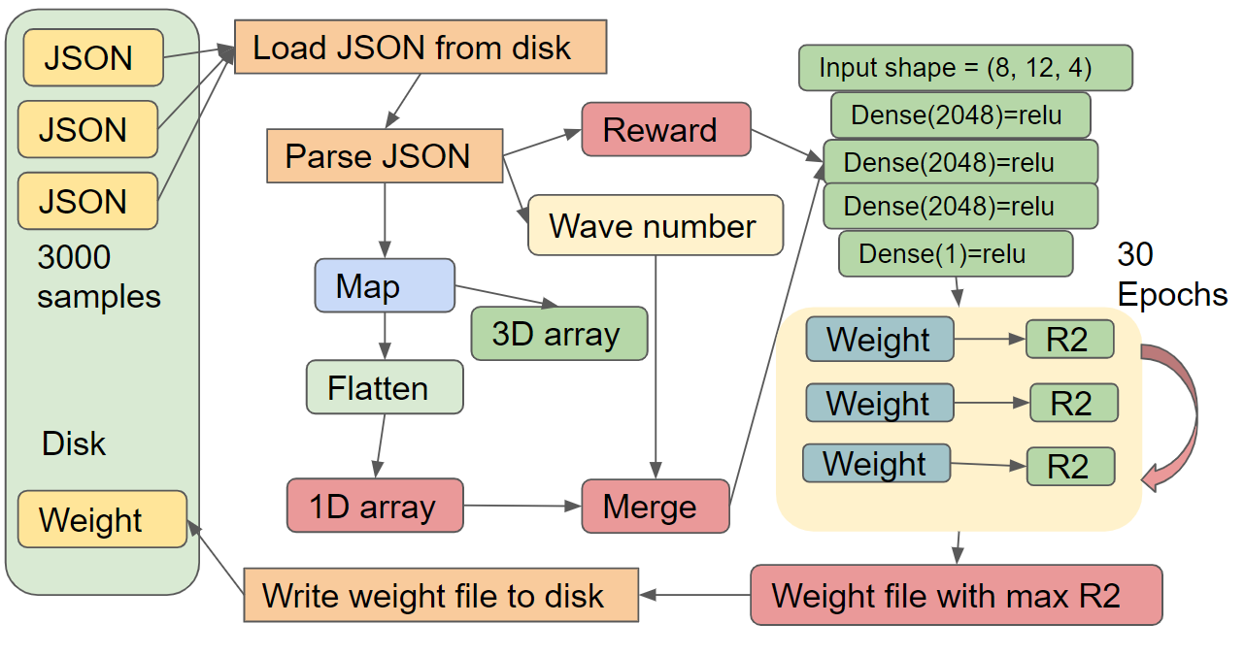
ML Application
Hyperparameters:
# of neurons per layer
# of layers
Drop out rate
Activation function
Optimizer
# of epoch
Hyperparameter Tuning for the Deep Neural Network Regression Model
R-squared: It provides a measure of how well observed outcomes are replicated by the model

Slide 14
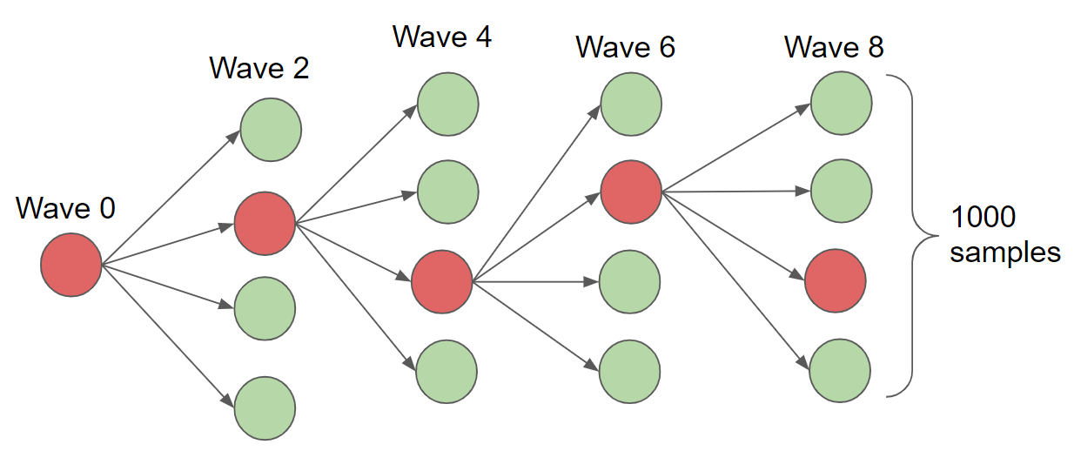
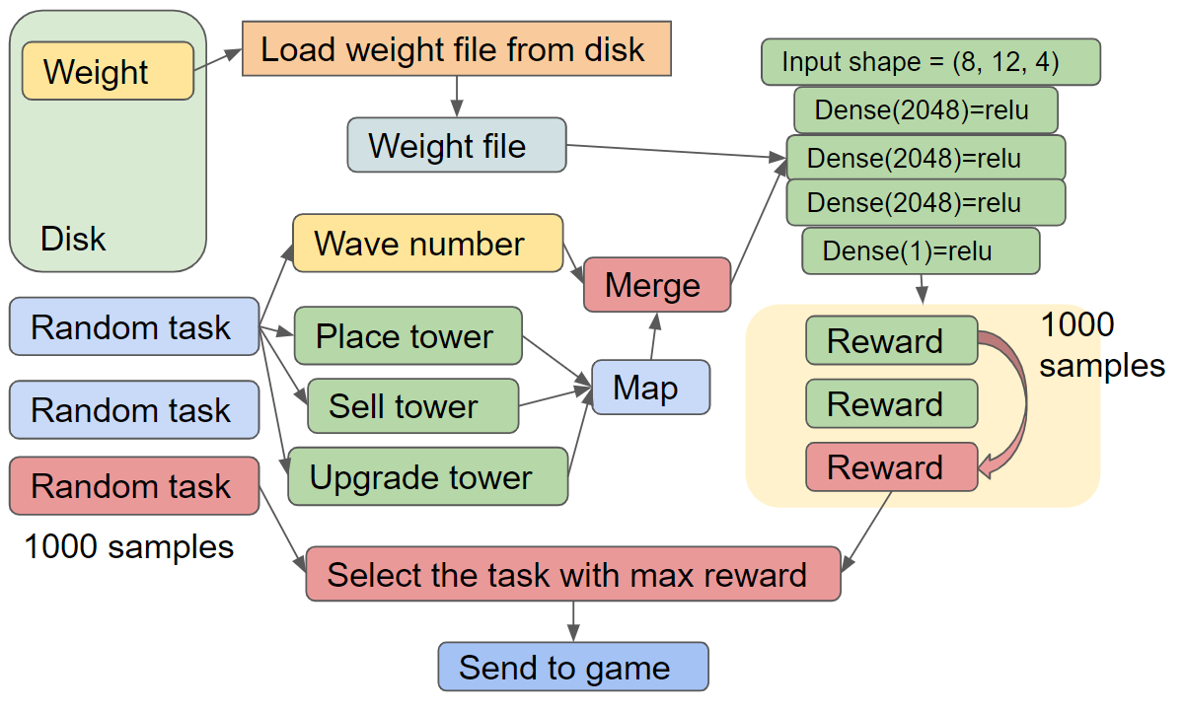
ML Application
Game Strategy Generation

Slide 15
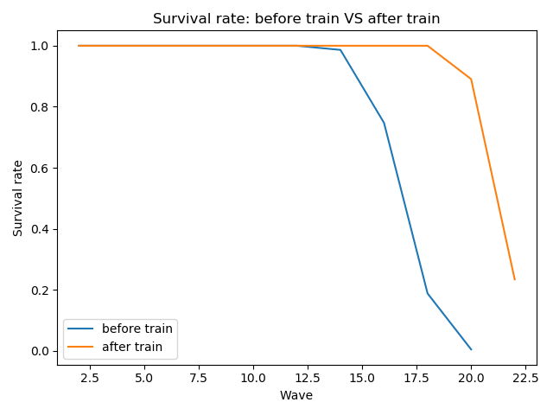
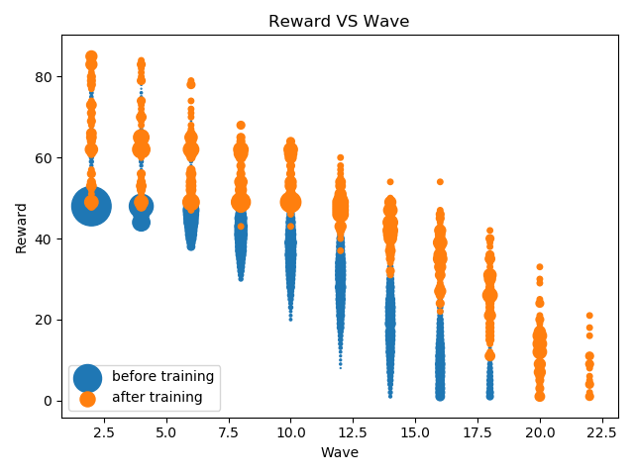
Performance Evaluation and Conclusion
 | Maximum survivable wave
CNN Model | 20
Deep Neural Network Regression Model | 22

Slide 16
Limitations & Future Work
Fix the bug caused the game to freeze.
Collect more training data after the bug has been fixed.
Explore to improve the model performance using newly collected bug-free training data.
Extend our model to more maps.

Slide 17
Demo Video

Slide 18
Thanks

